Slide 1
RISK vs. REWARD
“Every answer is a gamble. Every gamble is a choice.”
Created by: Eddie Lawhorn 📧 eddie.lawhorn.author@gmail.com | 📞 256-975-2238 | 🌐 eddie.lawhorn.creative.com

Slide 2
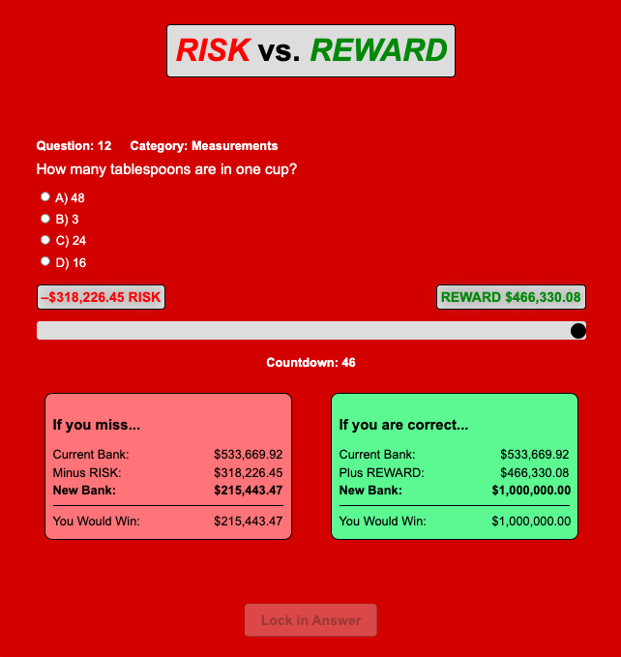
A deceptively easy question… worth a million dollars. Would you know it – or would you guess just outside the mark?
Concept Overview
What is RISK vs. REWARD?
A high-stakes trivia game show where contestants control their fate using a dynamic RISK/REWARD slider.
Each of 12 questions lets them choose a category and set how much they’re willing to risk – and how much they stand to gain.
The more they risk, the more they can win… or lose.
At maximum risk, a perfect game earns $1,000,000. Miss every question? You still walk away with $0.01.

Slide 3
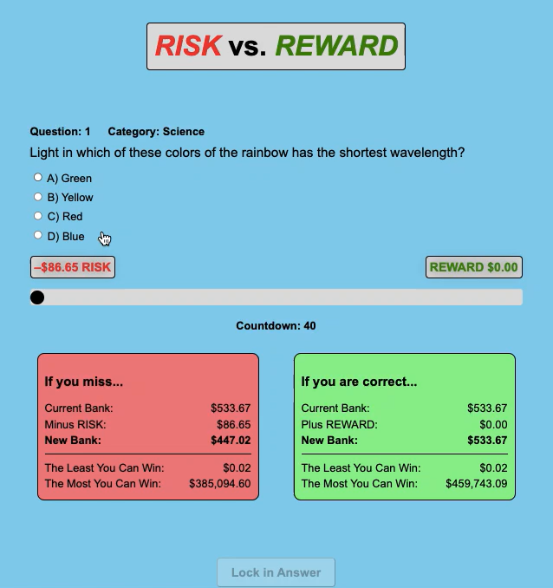
Click the video. See the stakes unfold – how would you play?
How It Works
12 multiple-choice questions
Choose from a fixed set of 13 trivia categories
Adjust the RISK/REWARD slider before each answer
One “Do Over” lifeline
No walking away – every question must be answered
Timer locks in your answer and slider if time runs out

Slide 4
The Stakes
RISK and REWARD values compound over time
Early rounds build slowly
Final rounds can spike dramatically
One wrong answer can drastically reduce your total
Strategic slider use is key to maximizing winnings
Each step intensifies the risk. The million isn’t just a number – it’s the final leap that separates legends from hesitation.

Slide 5
What Makes It Unique
Slider Mechanic – Contestants control their own stakes
Psychological Pressure – Strategy meets stress
No Walk-Away Option – Every decision counts
Compounding Rewards – Like interest, the stakes grow
Couples Mode – Adds emotional tension and teamwork

Slide 6
Tone & Host
Charismatic, lightly comedic host
Balances tension with humor
Keeps the energy high and the gameplay fun
“You start the game with $533.67. The producer says that’s for putting up with me.” “Don’t worry about the money – I get paid the same no matter how you do.”

Slide 7
Audience & Appeal
Ages 18-49, broad gender appeal
Trivia fans, gamblers, strategists, and casual viewers
Viewers love debating: “What would you have done?”
Build-in social buzz and replay value

Slide 8
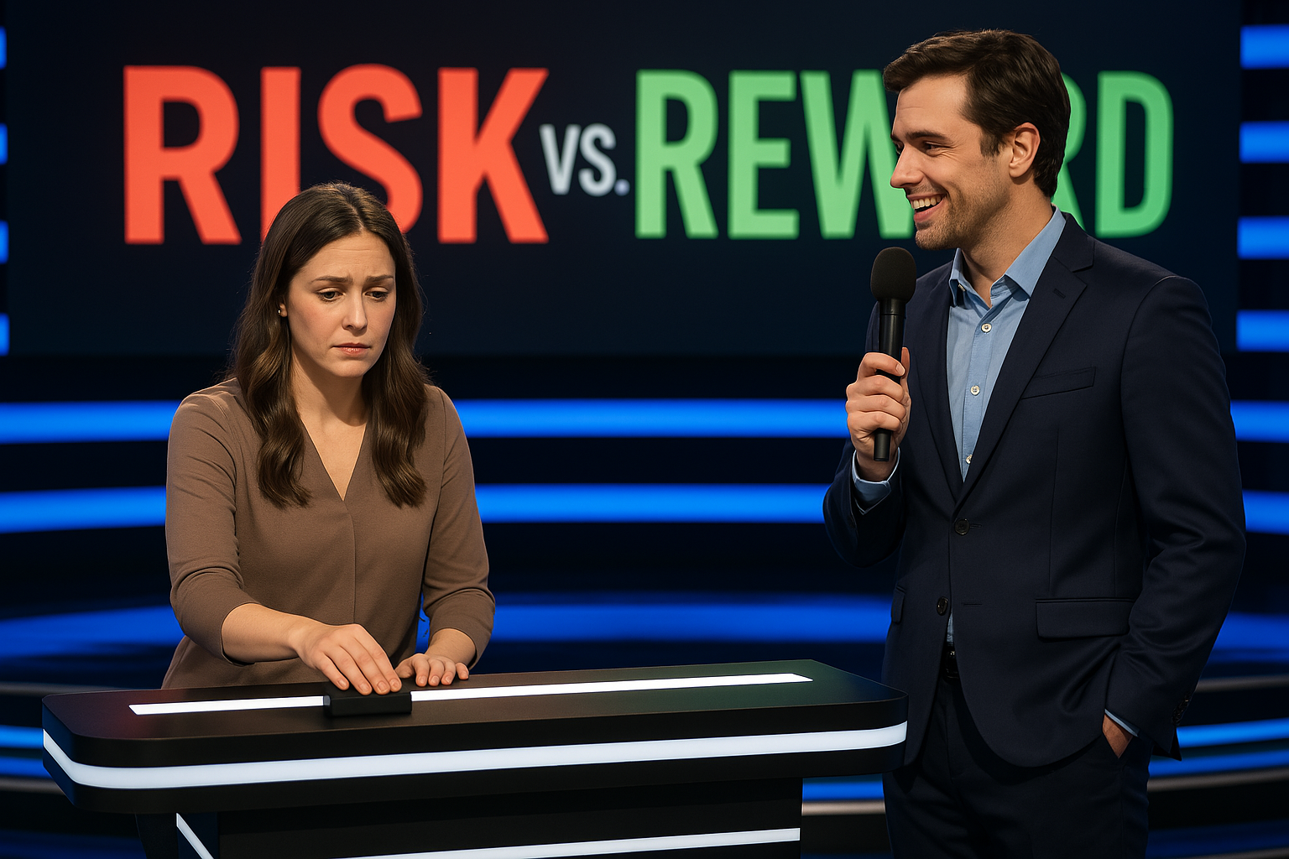
Set & Visual Style
Sleek, modern set with a central slider control
Real-time graphics show RISK, REWARD, and trajectory
Countdown timer and dramatic lighting build tension
Designed for high visual impact and audience immersion

Slide 9
Spin-Off Potential
Couples Edition – Shared decision-making and drama
High Stakes Week – Bigger prizes, tougher questions
International format potential with localized trivia

Slide 10
RISK vs. REWARD
It’s more than a trivia game. It’s a test of nerve, knowledge, and how far you’re willing to go.
A working prototype is available for hands-on demonstration upon request.
Created by: Eddie Lawhorn 📧 eddie.lawhorn.author@gmail.com | 📞 256-975-2238 | 🌐 eddie.lawhorn.creative.com

